Slide 1
Managing Short-Term Resources and Obligations
October 13th, 2022
Wenchen Wang
Notes:
In Chapters 7 and 8 the focus shifts from planning for the organization, to implementation of the organization’s plans and control of the organization’s results. An important part of the implementation of plans is the careful use of short-term resources and obligations. We are going to talk about techniques and approaches designed to maximize the benefit of short-term resources and minimize the cost of short-term obligations. By short-term, we are generally referring to a period of less than 1 year. Short-term resources, often called short-term assets, current assets, or near-term assets, are those resources that are cash or will be either converted to cash or used up within 1 year. Short-term obligations are those that will have to be paid in cash within 1 year.
Careful management of short-term resources and obligations can, in some cases, make the difference between ceasing operations and continuing to stay in existence.

Slide 2
Learning Objective
Working Capital Management
Short-Term Resources
Short-Term Obligations

Slide 3
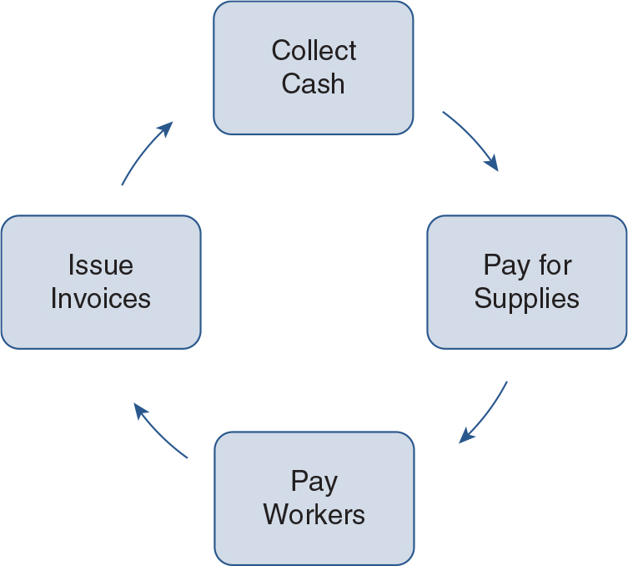
Working Capital Management
Net Working Capital is defined as the resources that an
organization can use to provide goods and services over the next year (Short-Term Assets) less what the amount that will have to be paid to other organizations and individuals over the coming year (Short-Term Liabilities).
Net Working Capital = Current Assets--Current Liabilities
Notes:
Management of current assets and current liabilities to maximize results. Working capital management focuses on making sure that the organization has the resources it needs to operate during the current year. It is a continuous process.
Working capital is based on a cycle of inflows and outflows. Short-term resources and short-term obligations

Slide 4
Short-Term Resources
Cash
Cash on hand and cash that can be withdrawn from the bank
Marketable securities
Investments that the organization can buy/sell in financial markets
Receivables
Bills that have been sent out by the organization but have not yet been collected
Inventory
Goods available for sale
Supplies to provide goods or services to clients
Notes:
The most essential financial resource is cash. Cash is needed to pay obligations as they come due. Cash is generally defined as both currency on hand and also amounts that can be withdrawn from bank accounts.
A second type of short-term resource is marketable securities. These investments can be bought and sold in financial markets, such as stock and debt markets. Marketable securities provide managers with an outlet to invest idle resources while maintaining access to the resources when needed.
Receivables often are the largest working capital item.
Inventories, which are goods available for sale or supplies that organizations have purchased to provide goods and services to clients but have not yet used.

Slide 5
Cash
Main reasons to have cash on hand
Transactions
Safety
Investments
The more cash the organization has, the better ?
No → Trade-offs
Bank: Provides safety
→ May reduce the level of service provided
Notes:
Cash is essential for working capital management due to a 3 reasons:
First, cash is needed for the normal daily transactions of any activity. For example, cash is needed to pay employees and suppliers.
Future is unforeseeable therefore cash can provide a safety margin for the organization.
Investments—new profits
Managers must find an appropriate cash level that is reasonably safe but does not unduly restrict the organization’s pursuit of its primary mission. Eg: only buying one truck and leaving the rest in the bank would hinder the mission accomplishment of the organization
managers must anticipate when organizations will receive the cash. Similarly, managers must anticipate what cash will be required for payments and when they must be made. The cash excess or shortfall is calculated for each period. This is what we talked about accounting in Chapter 2.

Slide 6
Cash
Cash excess
Bank account → interest-bearing accounts
Look for higher rates of return
Decrease liquidity
Increase risk
Eg:
Certificate of deposit (CD)
Marketable Securities
Repay loans & expand services
Cash shortage
Collect receivables
Hold off on payments
Ask for a loan
Notes:
By contrast, if money is put into a higher-yielding investment such as a certificate of deposit (CD), there may be a penalty for early withdrawal. CDs generally tie up the organization’s money for at least a month. However, they pay interest rates higher than savings accounts.
Other investments hold promise of even higher rates of return but entail greater risks. For example, cash can be invested in marketable securities such as corporate stocks and bonds. Such investments are subject to market fluctuations. That means that their value might fall.

Slide 7
Marketable Securities
Cash investments that have a ready market for purchase and sale
Can be sold almost immediately
Cash from the sale will be received in a few days
Factors to consider when making investments
Investment is legal
Risk
Return
Risk/Return Trade-off: Riskier the investment – The higher its expected return
Liquidity
How quickly it is converted to cash
Trade-off: Return & Liquidity
Notes:
There are two major categories of marketable securities: equity securities and nonequity instruments. Equity is an ownership interest. Shares of stock, which for-profit corporations issue in exchange for money, are equity securities. The people who buy the stock become owners of the corporation, though any one person usually owns just a tiny fraction of the company
Bonds and notes, meanwhile, are referred to as either debt instruments or nonequity instruments. The borrower sells the debt instrument to the lender—the lender is the buyer. . The lender owns the debt instrument but does not own any part of the organization borrowing the money. If an organization that has sold bonds does poorly, it is still obligated to repay the full amount it has borrowed. The market value of bonds may rise or fall, but the buyer of the bond is reasonably certain to be repaid the face value of the bond at maturity, in addition to periodic interest payments, if the borrower remains solvent.

Slide 8
Account Receivables
Invoice issues
Invoice received by customer
Invoice paid by customer
Payment received
Payment deposited
Receive payments in the future
Buying the service on account
Notes:
Accounts Receivable--bills that have been sent out by the organization but have not yet been collected. Although some organizations collect payment at the same time they provide goods or services, that is not always the case. Sometimes people owe money for goods and services provided to them now and pay at some time in the future. In that case, they are buying the service on account. The amounts they owe are called receivables by the organization that has provided the goods or services. Because organizations want to keep track of or account for how much is owed to them, the amounts owed are often called accounts receivable.

Slide 9
Account Receivables
Monitor unpaid receivables
Collect receivables as quick as possible
To be invested, pay bills, or expand services
Risk: Some are not collected / bad debts
Develop credit policies
To whom services will be provided
who it will charge for the services
Aging Schedules are a valuable management tool
Notes:
One of the most important issues confronting the manager is how to collect receivables as quickly as possible. This is sometimes referred to as revenue cycle management. The sooner receivables are collected, the sooner the money can earn interest or be used to pay bills or expand services. Organizations are also concerned that some receivables will never be collected. Efforts to collect receivables promptly reduce that likelihood. Therefore, there should be an attempt to reduce the time required for each step in the accounts receivable cycle, shown in the flow chart here.
Credit PoliciesBy excluding individuals or organizations from buying goods or services on account, an organization takes a chance of losing the opportunity to provide some services. The manager must weigh the risk of nonpayment against the potential loss of business.
Accounts receivable aging schedule, which shows how long it has been between the current date and the date when uncollected bills were issued. The aging schedule is a valuable tool because problem areas can be quickly identified.

Slide 10
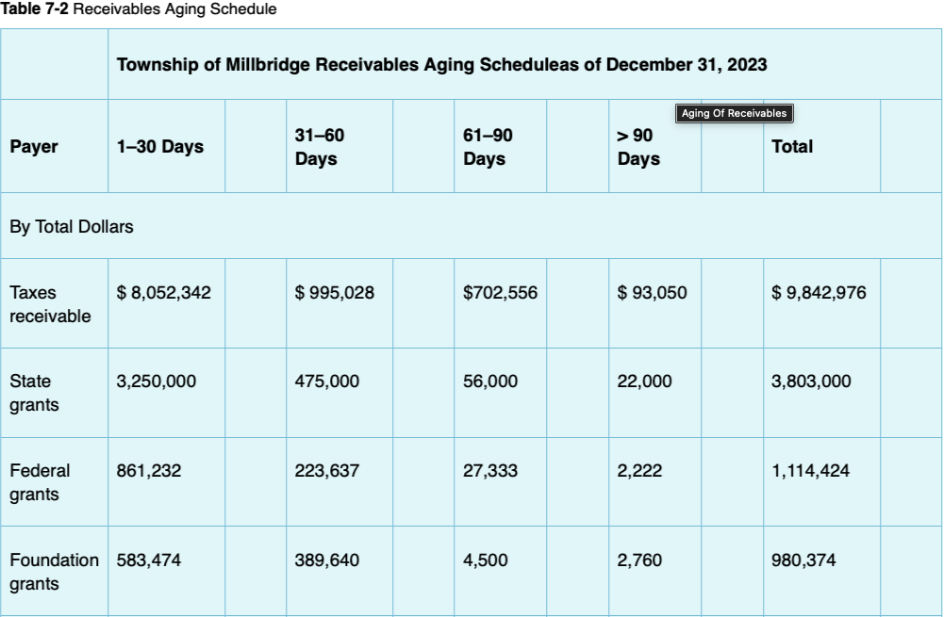
Account Receivables
Notes:
For Account Receivable management, efforts to collect payment should begin as soon as the invoice is issued. If anything goes beyond the current column (i.e., 1–30 days), there should be a formal procedure, such as the issuance of a reminder statement. If an account exceeds 60 days there should be procedures such as mailing another statement, often colored pink to get greater attention. The > 90-day category in an aging schedule is a particular concern, even though it may be a small part of the total. Amounts in that category probably reflect problems encountered in processing the bills or else an inability or unwillingness to pay. All organizations should have specific follow-up procedures for accounts that fall into this category. These procedures should include not only monthly statements, but also late charges and telephone calls to determine why payment has not been made. The longer a payment goes unpaid, the less likely it will ever be paid.

Slide 11
Inventory
Supply items that an organization buys and uses to make products or services
General rule of thumb: Inventory levels should be kept as low as possible
Centralized
Inventory storage
Ordering process
Notes:
For example, Meals might purchase cans of food to use when inadequate donations of fresh food are received on a given day
The lower the level of inventory, the less an organization must pay out to suppliers, and the greater the amount of money it can keep in interest-bearing savings accounts or investments.
When possible, inventory storage should be centralized. If an organization creates separate locations for inventory, convenience rises but so do costs. The more geographically separated the storage sites are, the greater the amount of each inventory item the organization is likely to have.
The ordering process should also be as centralized as possible. The more decentralized the ordering process, the more time employees spend ordering the same item. Ordering decentralization is also likely to lead to payment of a higher price per unit since the organization is less likely to take advantage of volume discounts.

Slide 12
Inventory
Economic Order Quantity (EOQ)
Considers additional costs related to the inventory
Relative costs of ordering large amounts of inventory infrequently VS ordering small amounts more frequently
Carrying costs / Holding costs
Ordering costs
EOQ balance the two factors to find the optimal amount to order
Notes:
There are many costs associated with inventory other than the cost for purchasing: An organization must have physical space to store it, it may need to pay to insure it, and there are costs related to placing an order and having it shipped. A method called the economic order quantity (EOQ) considers all these factors in calculating the inventory level at which additional inventory should be ordered.
The more inventory that is ordered at one time, the sooner an organization pays for inventory and the greater the costs for things such as inventory storage. These are called carrying costs or holding costs of inventory.
Conversely, if the organization keeps relatively little inventory on hand to keep carrying costs low, it will have to order inventory more often. That drives ordering costs up.

Slide 13

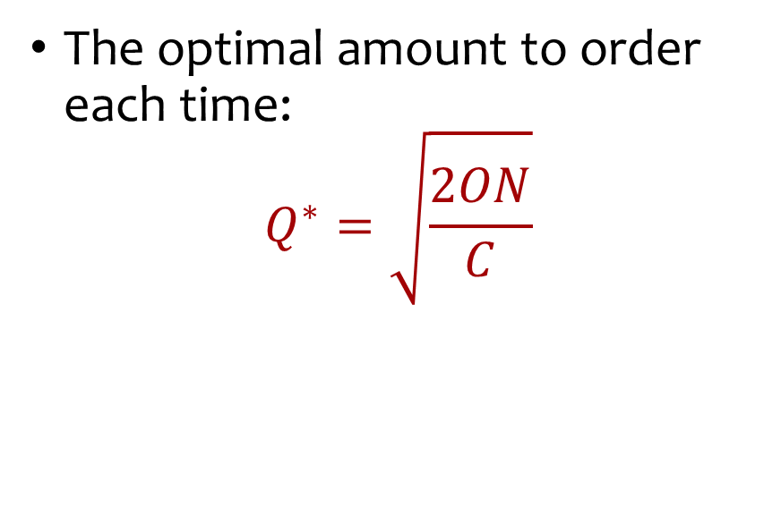
Economic Order Quantity (EOQ)
$$TC=PC+CC+OC$$
PC = P*N
$CC=C∗\frac{Q}{2}$
$OC=O∗\frac{N}{Q}$
The optimal amount to order each time:
$$Q^{∗}=\sqrt{\frac{2ON}{C}}$$
P: Price of each unit
N: Units needed in a year
Q: Number of units ordered each time
C: Carrying costs per unit
Q/2: Units on hand at any given time
O: Costs of making an order
N/Q: Number of orders per year

Slide 14
Economic Order Quantity (EOQ)
Example
A nonprofit needs 10,000 bags of rice every year. Each bag costs $7. The cost of placing an order is estimated at $50 per order. Carrying costs are estimated at 50 cents per bag per year.
How many bags should be ordered at a time?
How many orders per year should there be?
What is the total inventory cost?
How does it change if all the bags are purchased at the beginning of the year?

Slide 15
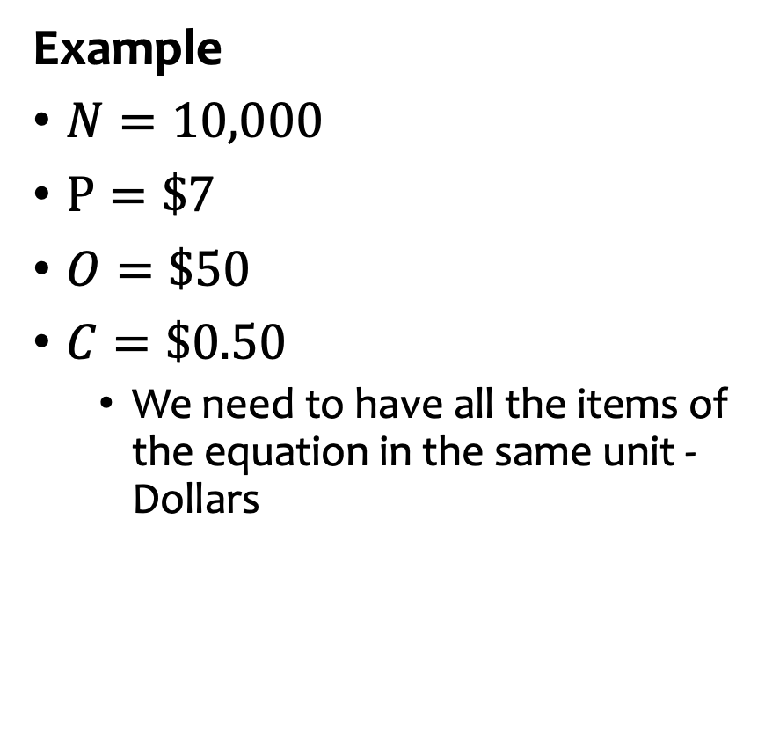
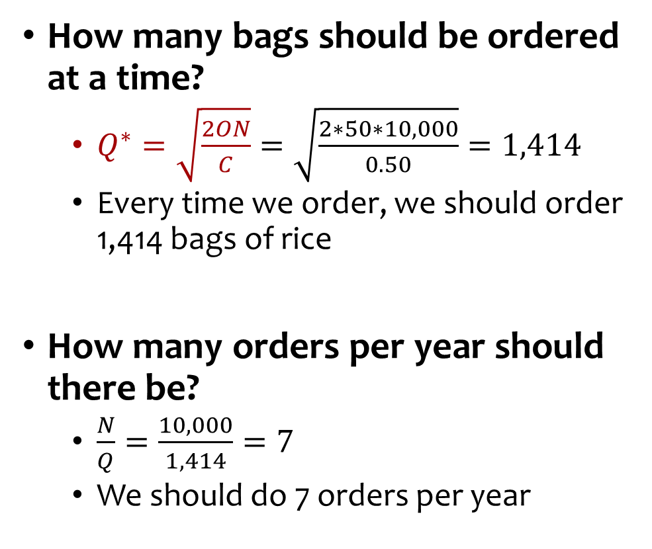
Economic Order Quantity (EOQ)
Example
$N=10,000$
$P=\$7$
$O=\$50$
$C=\$0.50$
We need to have all the items of the equation in the same unit - Dollars
How many bags should be ordered at a time?
$Q^{∗}=\sqrt{\frac{2ON}{C}}=\sqrt{\frac{2∗50∗10,000}{0.50}}=1,414$
Every time we order, we should order 1,414 bags of rice
How many orders per year should there be?
$\frac{N}{Q}=\frac{10,000}{1,414}=7$
We should do 7 orders per year

Slide 16
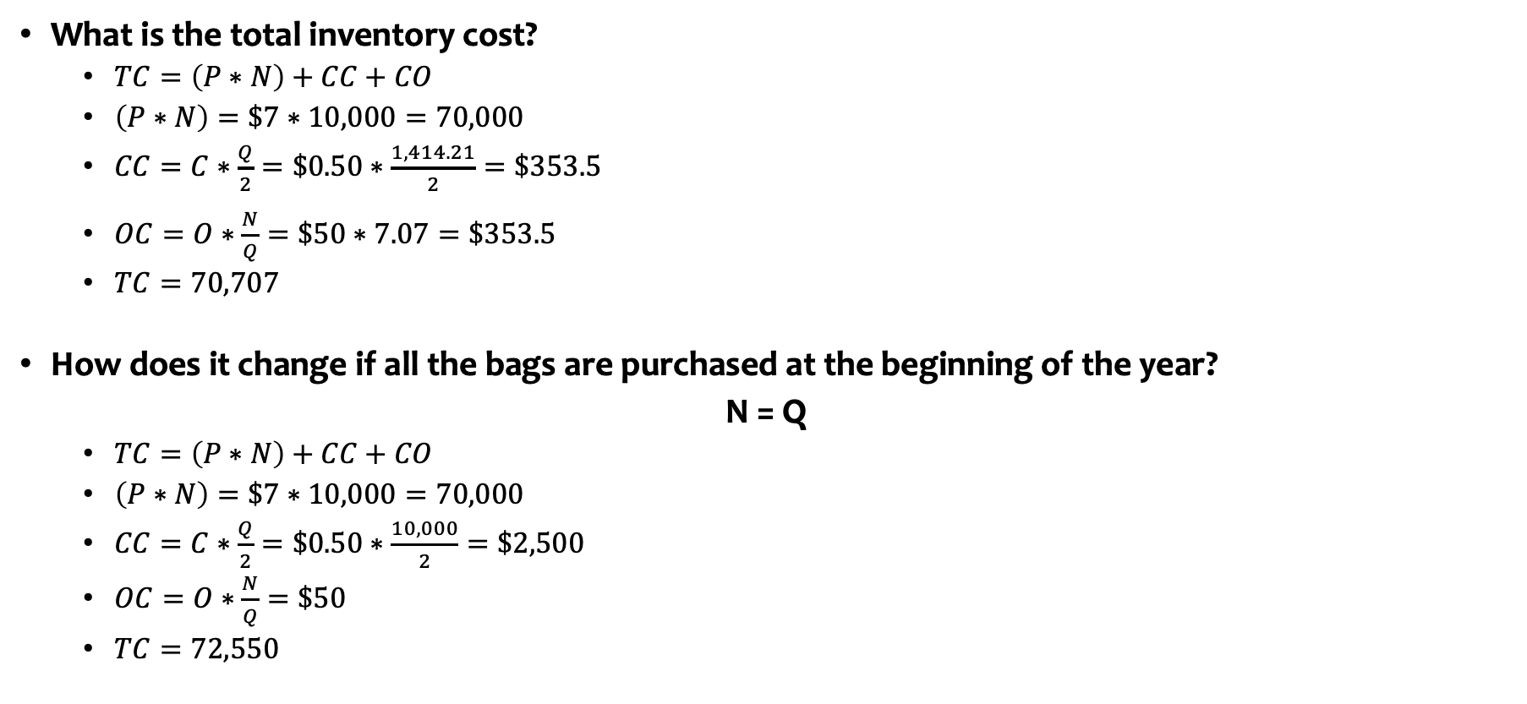
Economic Order Quantity (EOQ)
What is the total inventory cost?
$TC=\left(P∗N\right)+CC+CO$
$\left(P∗N\right)=\$7∗10,000=70,000$
$CC=C∗\frac{Q}{2}=\$0.50∗\frac{1,414.21}{2}=\$353.5$
$OC=O∗\frac{N}{Q}=\$50∗7.07=\$353.5$
$TC=70,707$
How does it change if all the bags are purchased at the beginning of the year?
N = Q
$TC=\left(P∗N\right)+CC+CO$
$\left(P∗N\right)=\$7∗10,000=70,000$
$CC=C∗\frac{Q}{2}=\$0.50∗\frac{10,000}{2}=\$2,500$
$OC=O∗\frac{N}{Q}=\$50$
$TC=72,550$

Slide 17
Short-Term Obligations
Accounts payable
Amounts owed to suppliers
Payroll payable
Amounts owed to employees
Short-term debt
Repay money that has been borrowed
Taxes payable
Payroll taxes
Notes:
Working capital management calls on managers to control costs related to both short-term resources and short-term obligations. To this point, this chapter has focused on short-term resources. We now turn our attention to management of short-term obligations, or current liabilities.
Accounts payable represent amounts that the organization owes to its suppliers. It is the flip side of accounts receivable.
A payroll payable is an amount owed to employees.
Short-term debt represents an obligation to repay money that has been borrowed.
Taxes payable represent not only income, sales, or real estate taxes, which many public service organizations are exempt from, but also payroll taxes that many tax-exempt organizations must pay.

Slide 18
Accounts Payable
Purchase items without paying immediately
No interest
Interest
Place an order
Order is delivered An invoice is issued
Due date
Notes:
When an organization purchases items without making an immediate cash payment for the full amount due, an account payable arises. Accounts payable are often called trade credit. In most cases, there is no interest charge for trade credit, if that payment is made when due.

Slide 19
Accounts Payable
Discounts
2/10 N/30
2 percent discount if paid within the first 10 days of the invoice date
IF NOT
The full amount of the invoice is due in 30 days
2/10 EOM (end of month)
2 percent discount in payments made no later than 10 days after the end of the month in which the invoice is issued
If it is offered, it usually pays to take the discount
Notes:
Some suppliers charge interest for payments received after the due date. Others do not. A common practice in many industries is to offer a discount for prompt payment.
Although a 2 percent discount might seem small, the organization earns that discount by paying perhaps 20 days sooner than it would otherwise pay the amount due. So the true interest rate is not 2 percent per year but rather 2 percent per 20 days. This generally works out to be a high annual rate

Slide 20
Accounts Payable
Example
A nonprofit organization orders supplies for $5,000. The NPO receives the supplies and the invoice the same day. In addition, it is offered a discount (2/10 N/30). What is the annual rate of return of the discount?
d10
d30
$4,900
$5,000
Need to find the interest rate that makes these two values equal

Slide 21



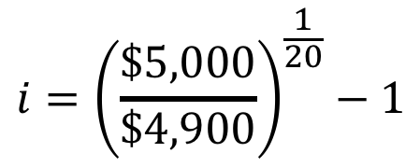
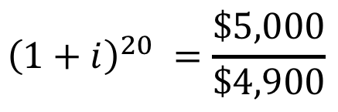

Accounts Payable
d10
d30
$4,900
$5,000
$$FV=PV{\left(1+i\right)}^{n}$$
2% discount is as if you were earning 36.5% on an annual basis
$$\$5,000={\$4,900\left(1+i\right)}^{20}$$
$${\left(1+i\right)}^{20} =\frac{\$5,000}{\$4,900}$$
$$i={\left(\frac{\$5,000}{\$4,900}\right)}^{\frac{1}{20}}−1$$
$$i=0.1\% daily$$
$$i=36.5\% annual$$
Notes:
Although a 2 percent discount might seem small, the organization earns that discount by paying perhaps 20 days sooner than it would otherwise pay the amount due. So the true interest rate is not 2 percent per year but rather 2 percent per 20 days. This generally works out to be a high annual rate

Slide 22
Short-Term Debt
Unsecured Loans—note payable
Secured Loans– money can be borrowed from collateral
The interest on a loan is equal to the amount of the loan multiplied by the annual interest rate multiplied by the fraction of the year that the loan is outstanding:
Interest=Loan Amount × Interest Rate per Year × Fraction of Year
Notes:
Typically, organizations obtain short-term debt by borrowing money from banks using unsecured notes.
However, in some cases money can be borrowed from financing and factoring companies, using inventory or accounts receivable as collateral, and in those cases the loans would be referred to as being secured loans.

Slide 23
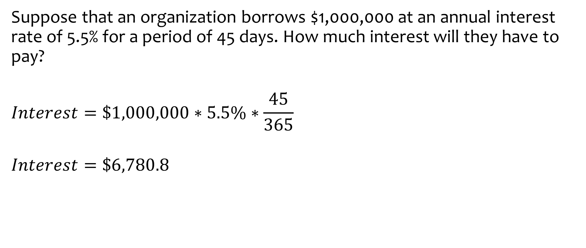
Short-Term Debt
Suppose that an organization borrows $1,000,000 at an annual interest rate of 5.5% for a period of 45 days. How much interest will they have to pay?
$$Interest=\$1,000,000∗5.5\%∗\frac{45}{365}$$
$$Interest=\$6,780.8$$

